Slide 1

Brains in Bits
A Comparative Study of PEFT Techniques for Commonsense Reasoning on GPT-2
04.21.25
Vishwanath Guruvayur
Luke Napolitano
Doruk Ozar

Slide 2
Agenda
DS6051 Presentation
1.
Defining the Motivation
2.
Dataset
3.
Methodology
4.
Results
5.
Conclusions and Future Work

Slide 3
Motivations and Problem Statement
Recent open-source advancements such as DeepSeek have demonstrated impressive capabilities in reasoning, summarization, and general language understanding compared to proprietary models
Accessing and fine-tuning proprietary models is often prohibitively expensive; we turn to open-source models like GPT-2, which are way smaller, offer full controllability and transparency, even though fine-tuning can be resource-intensive or overfit the data
This motivated us to explore Parameter-Efficient Fine-Tuning (PEFT) techniques lightweight methods that selectively train small parts of a frozen model
Notes:
Project scope went through a few phases, had to try different datasets, also compute problems for fine tuning, more compute resources needed than available to output meaningful text

Slide 4
DS6051 Presentation
Agenda
1.
Defining the Motivation
2.
Dataset
3.
Methodology
4.
Results
5.
Conclusions and Future Work

Slide 5
Our Data
CommonsenseQA is a multiple-choice question-answering dataset designed to test commonsense reasoning - everyday knowledge not explicitly stated in text.
Each question has 4 MCQ answer choices, with only 1 correct answer
Designed to challenge models on implicit world knowledge
Main Idea
Requires reasoning, not just surface-level pattern matching
Well-suited to test how each PEFT method "teaches" commonsense to a small model like GPT-2
Provides a standard benchmark to compare model learning efficiency

Slide 6
Agenda
DS6051 Presentation
1.
Defining the Motivation
2.
Dataset
3.
Methodology
4.
Results
5.
Conclusions and Future Work

Slide 7
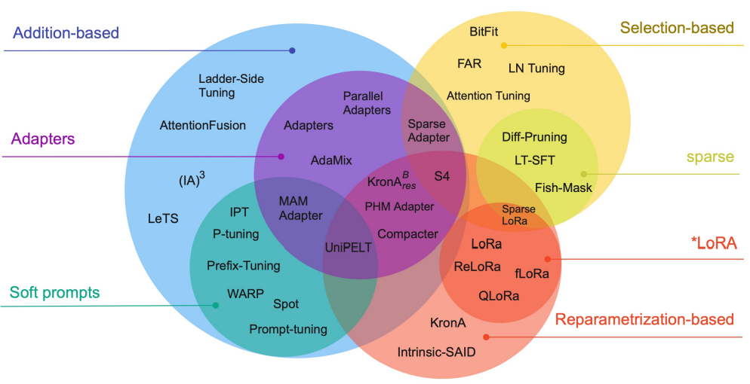
Parameter Efficient Tuning Methods

Slide 8
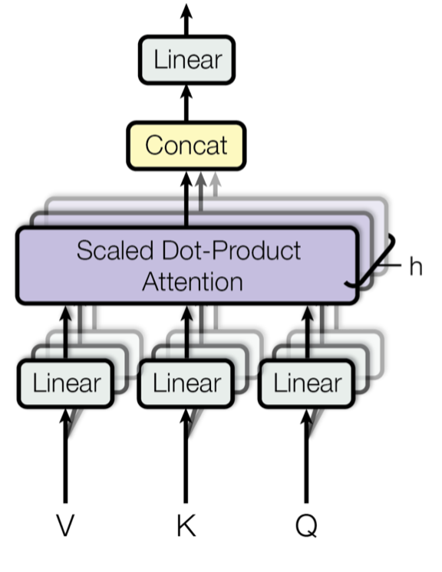
Methodology
Where does each method attack the Attention mechanism?
Dataset
CommonSense QA
785 Concepts
10 Broad Categories
IA³
Scales the Q, K, V
Tuning on GPT-2
LoRA
QLoRA
Prefix Tuning
IA³
LoRA & QLoRA
Add Low Rank Matrices to mainly K, V & also Q
Evaluation
Prefix Tuning
Accuracy
across categories
Perplexity
overall comparison
Prepends trainable tokens to the K, V and other hidden layers
Notes:
IA3 scales specific tokens to understand certain concepts yet
Prefix tuning gives more space to learn
LoRA, QLoRA splits linear layers up into lower-rank matrices for faster computation

Slide 9
Agenda
DS6051 Presentation
1.
Defining the Motivation
2.
Dataset
3.
Methodology
4.
Results
5.
Conclusions and Future Work

Slide 10
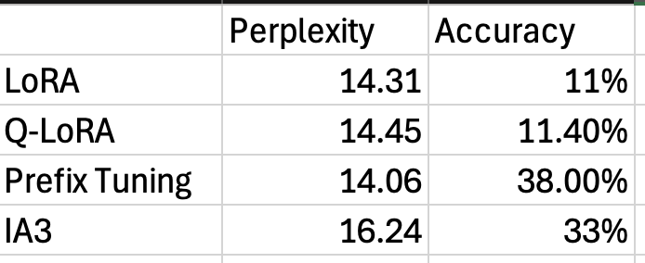
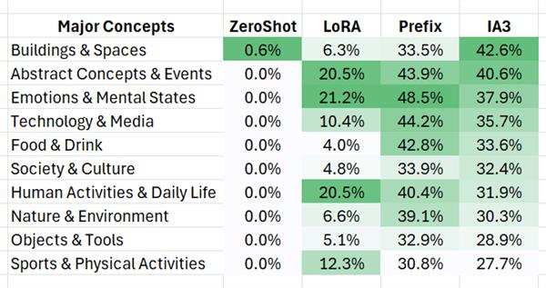
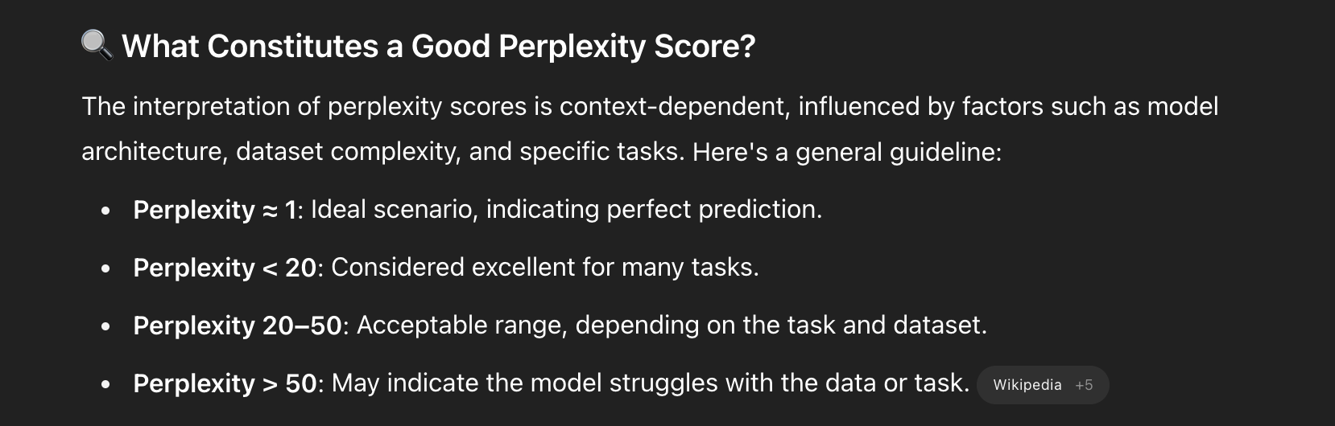
Results
Perplexity Score: assesses a language model's ability to predict the next word in a sequence.
Initial dataset gave us a training loss of 6.6 and flatlined.
Incorporating more fine-tuning and changing our dataset resulted in a much lower training loss

Slide 11
Agenda
DS6051 Presentation
1.
Defining the Motivation
2.
Dataset
3.
Methodology
4.
Results
5.
Conclusions and Future Work

Slide 12
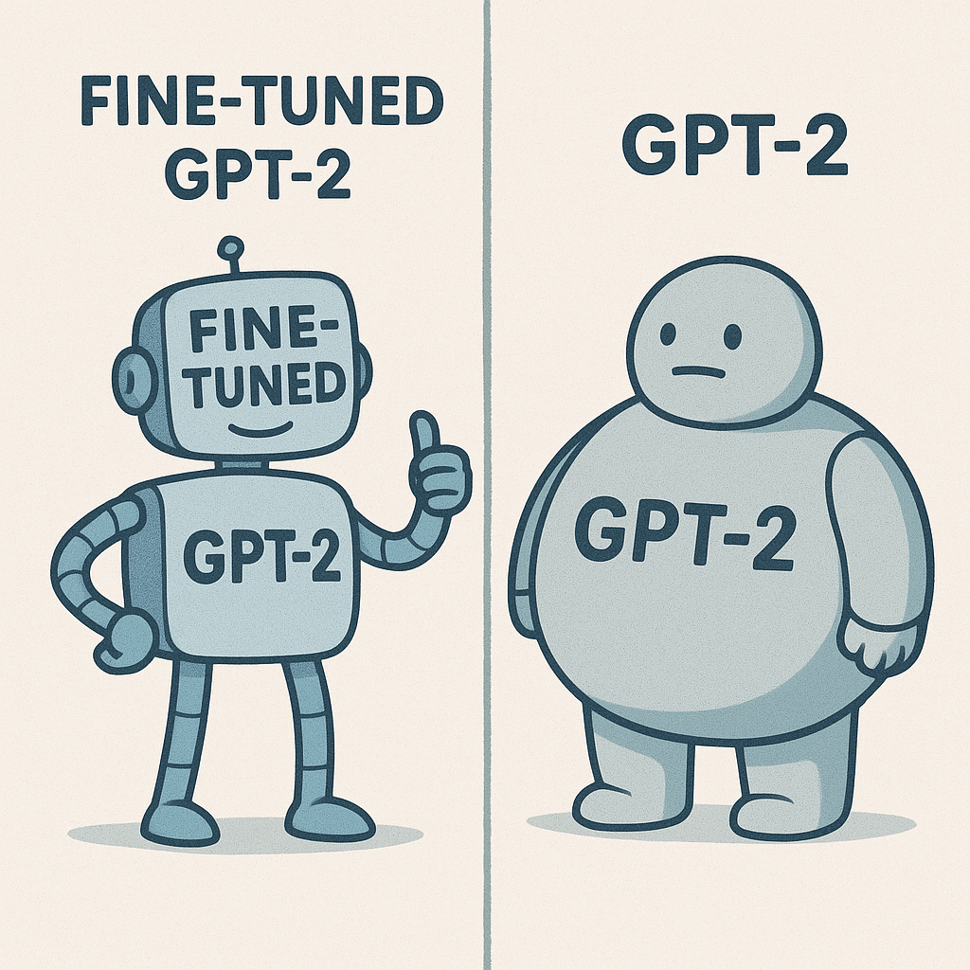
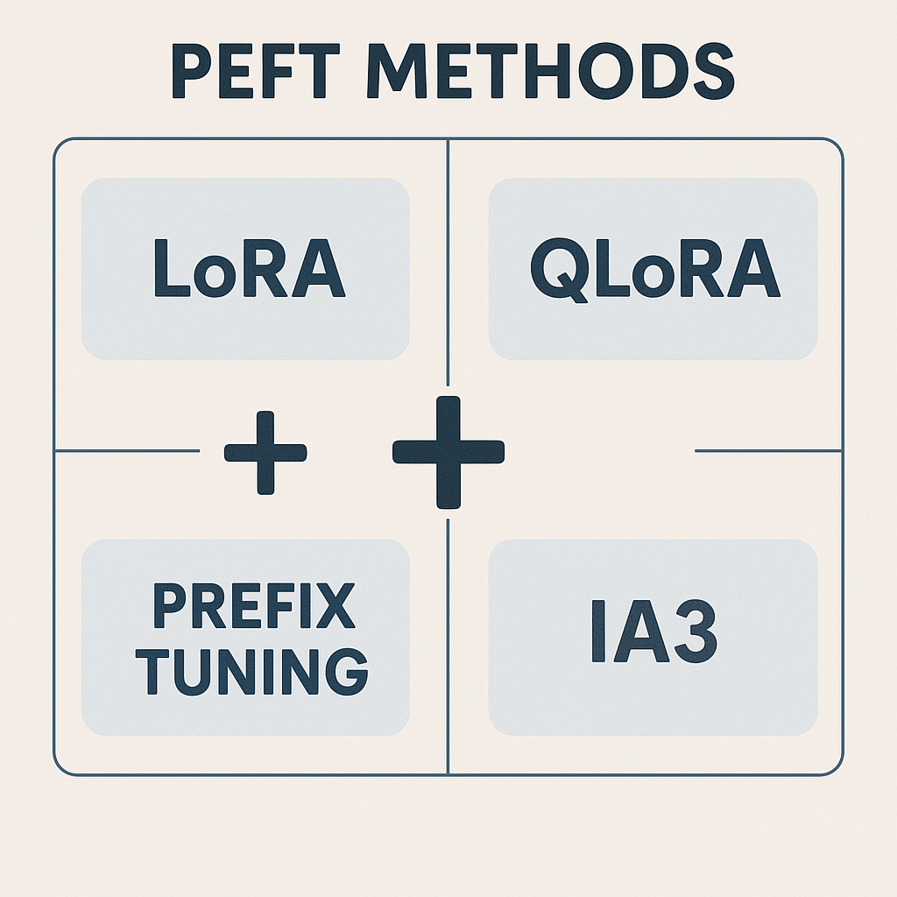
Conclusions
Future Work
Accuracy increase after Fine Tuning (to 38%)
Significant decrease in perplexity score!
IA3 and Prefix Tuning way better than LoRA
More advanced PEFT Techniques
Ensemble of Tuning Methods
Larger Reasoning LLMs - like Mistral
More Advanced Datasets

Slide 13
Thank You! Questions?

